Slide 1

Post-Service Success: Demographic and Socio-Economic Insights of Veterans in USA
Submitted By
Gokul Gangadharan
100950836

Slide 2
Objective
The presentation explores the post service performance of the US veterans based on their demographic and socio-economic status.
Demographic Insights: Understand veterans age, gender, marital status, recruitment patterns & ethnic diversity.
Socio-Economic Status: Assess the performance (income & capital gains) based on educational attainment, work sector & occupation.
Notes:
Veterans: People served in the military, who have completed their service and discharged from active duty.

Slide 3
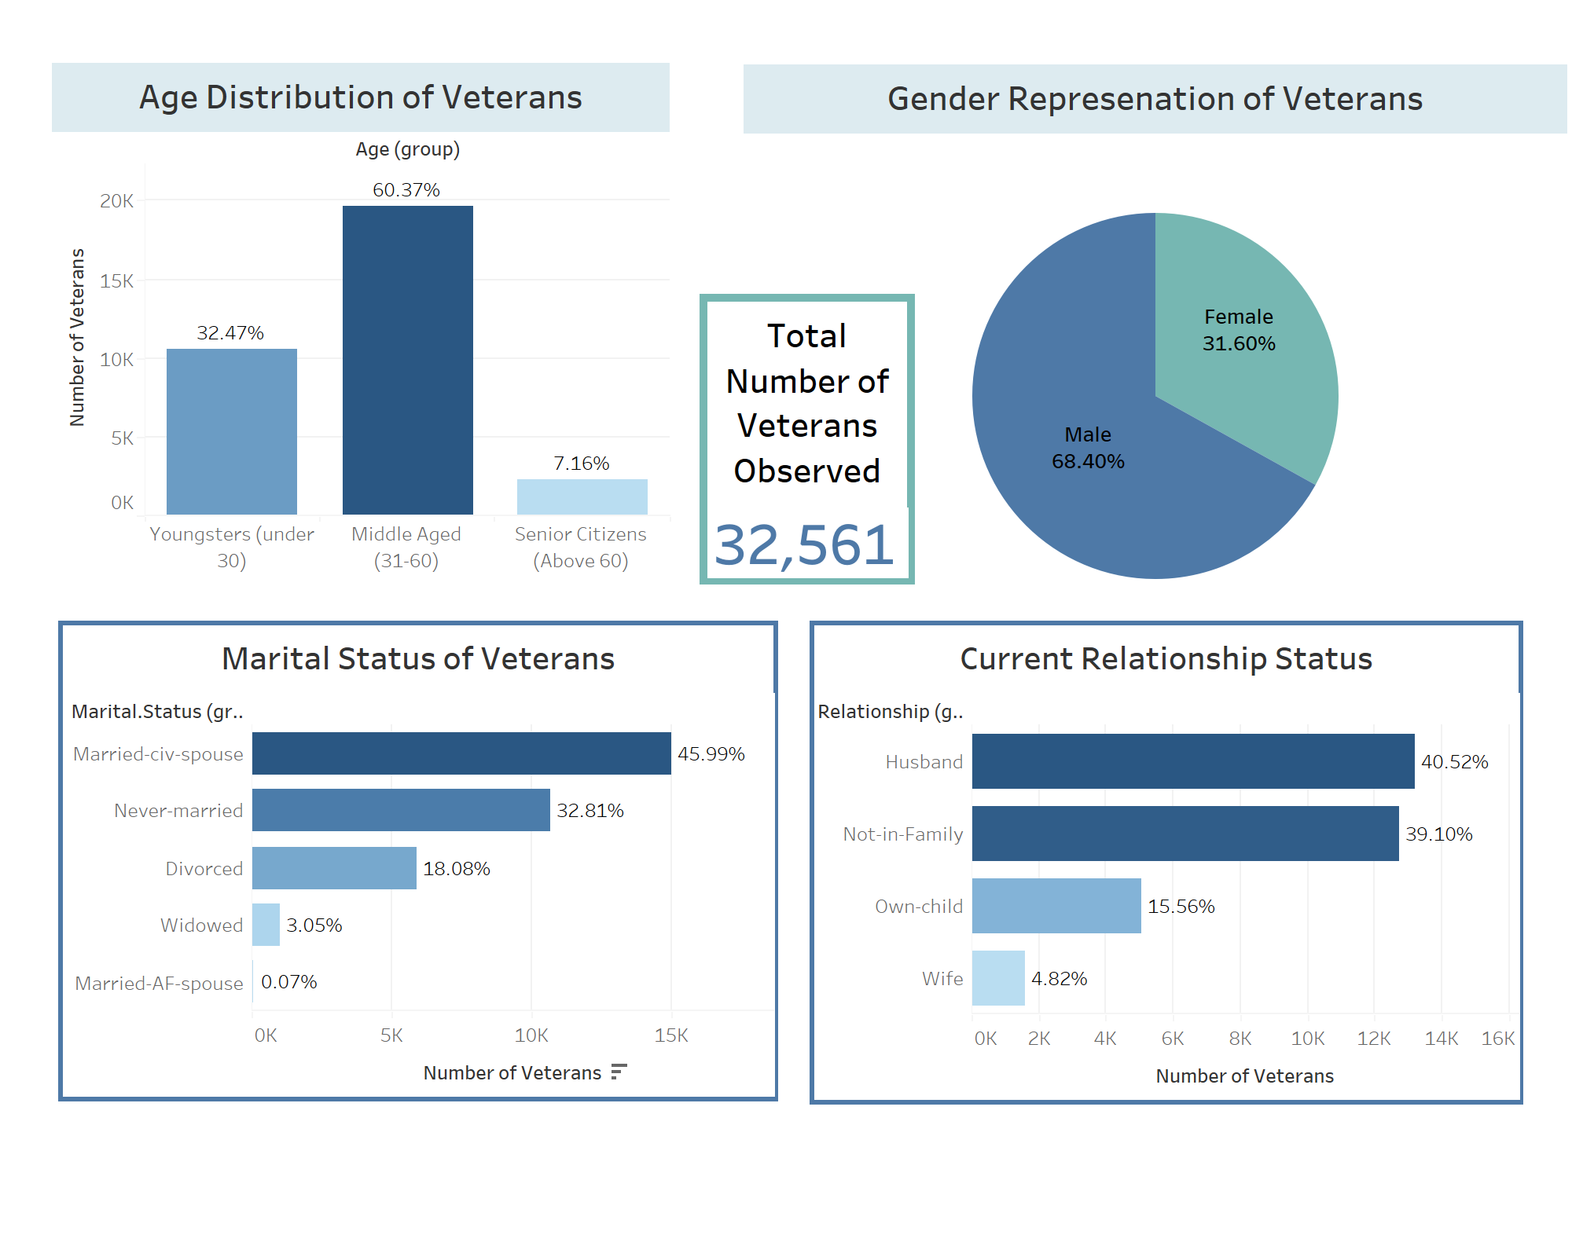
DEMOGRAPHICS

Slide 4
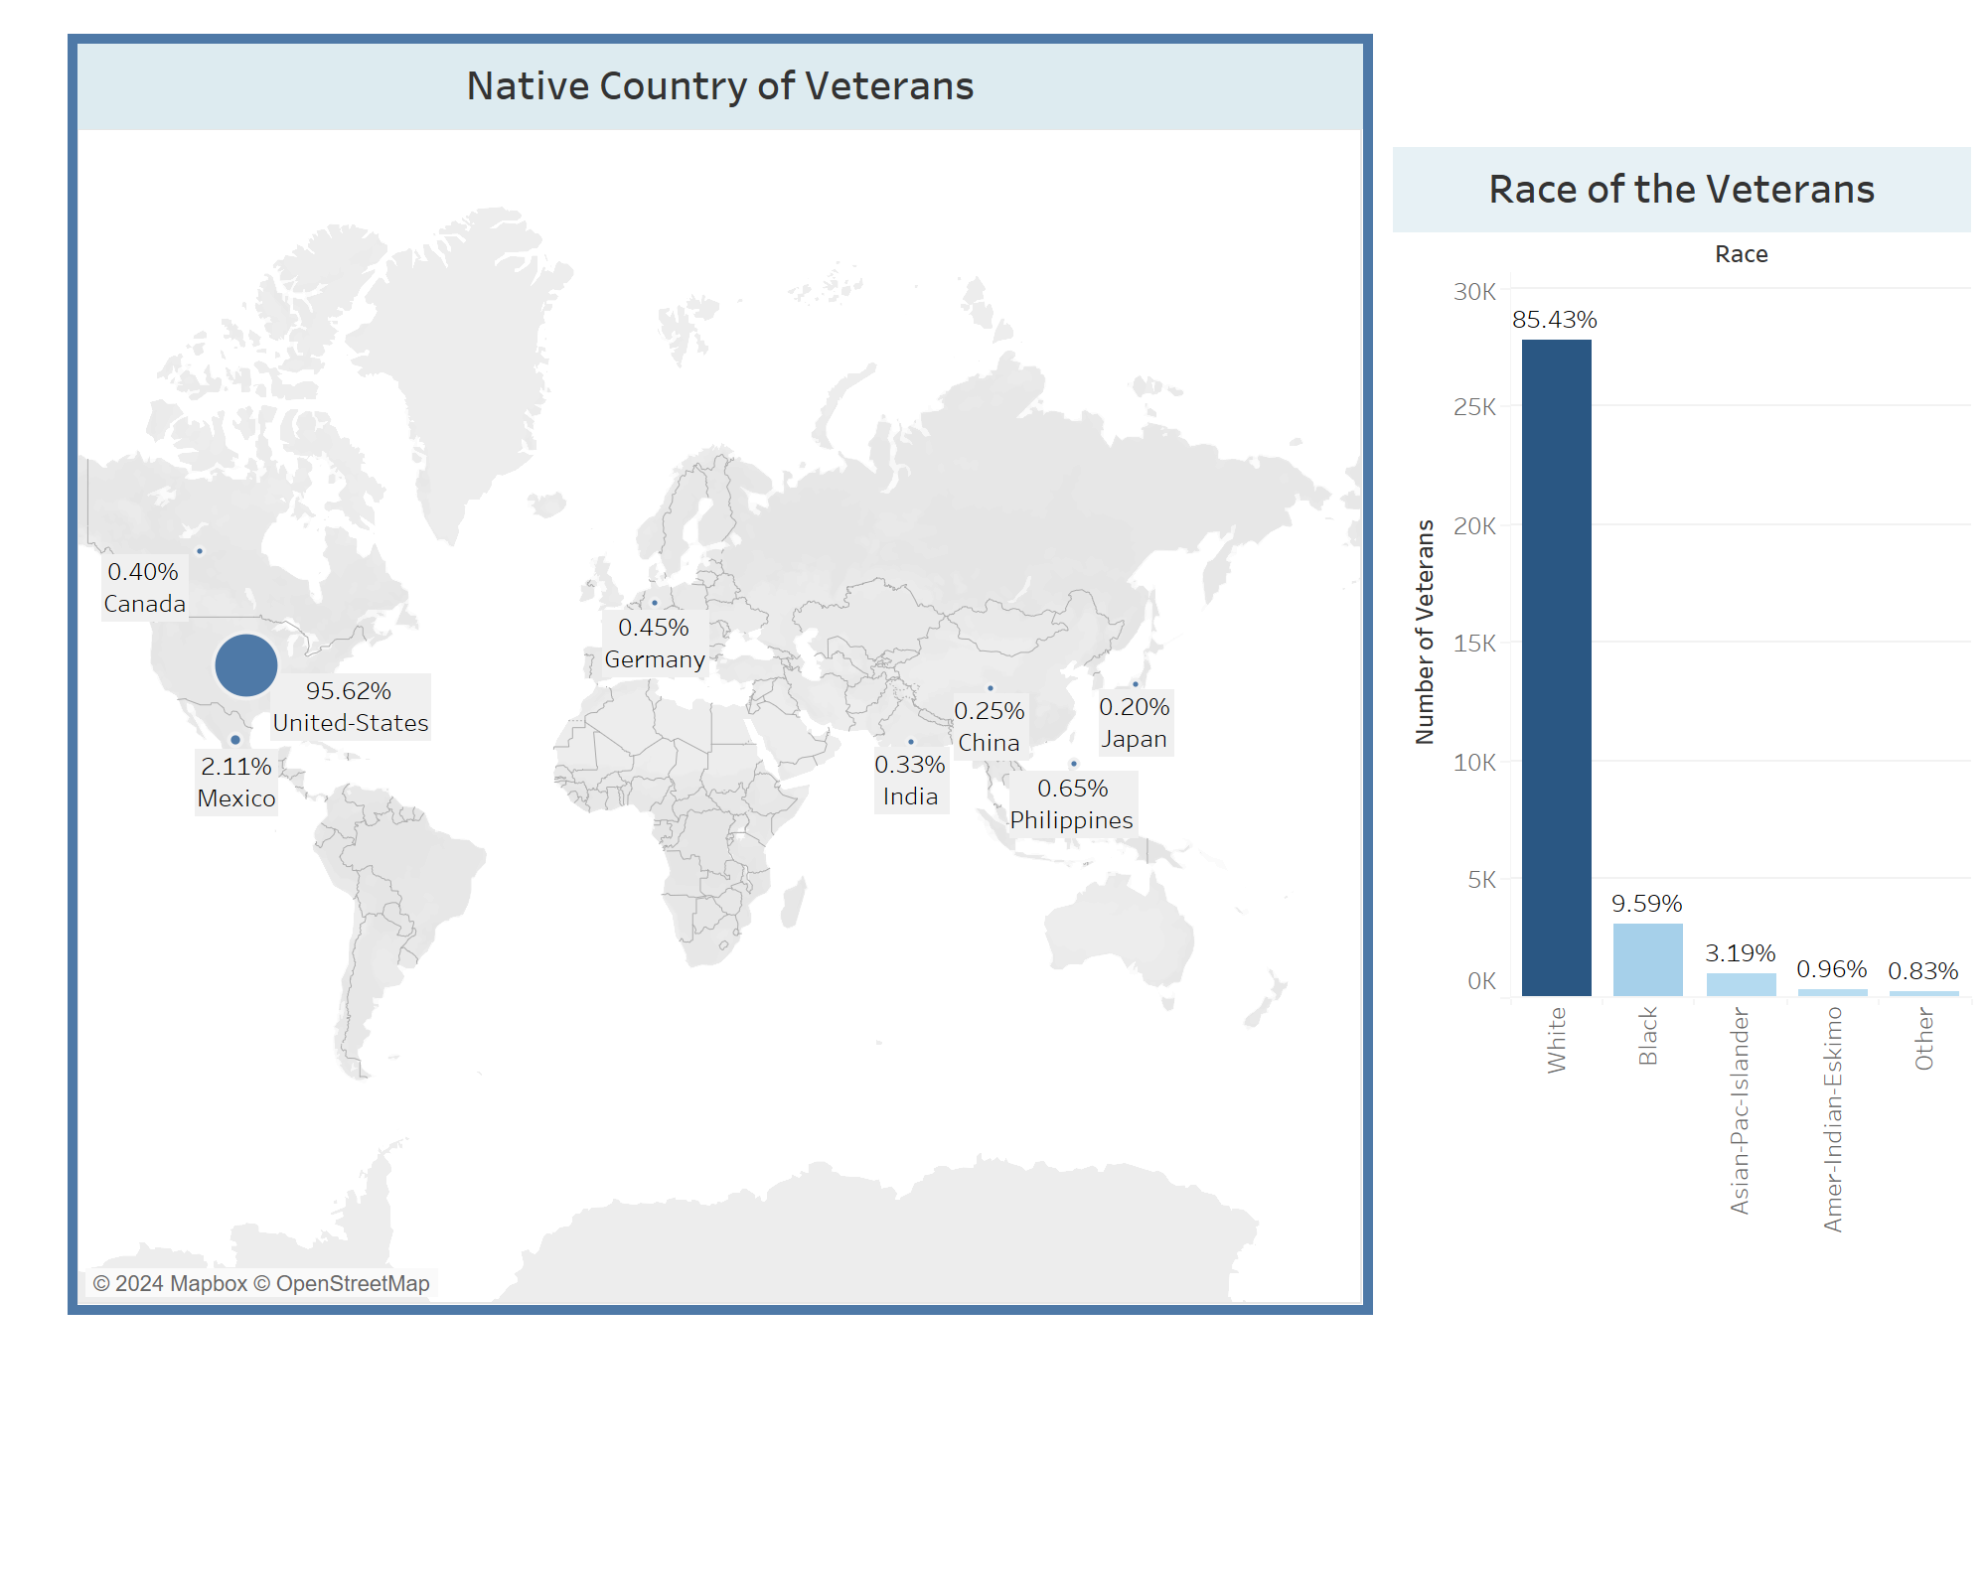
RACE & ETHNICITY
Notes:
Majority of veterans are Caucasians and American Citizens.

Slide 5
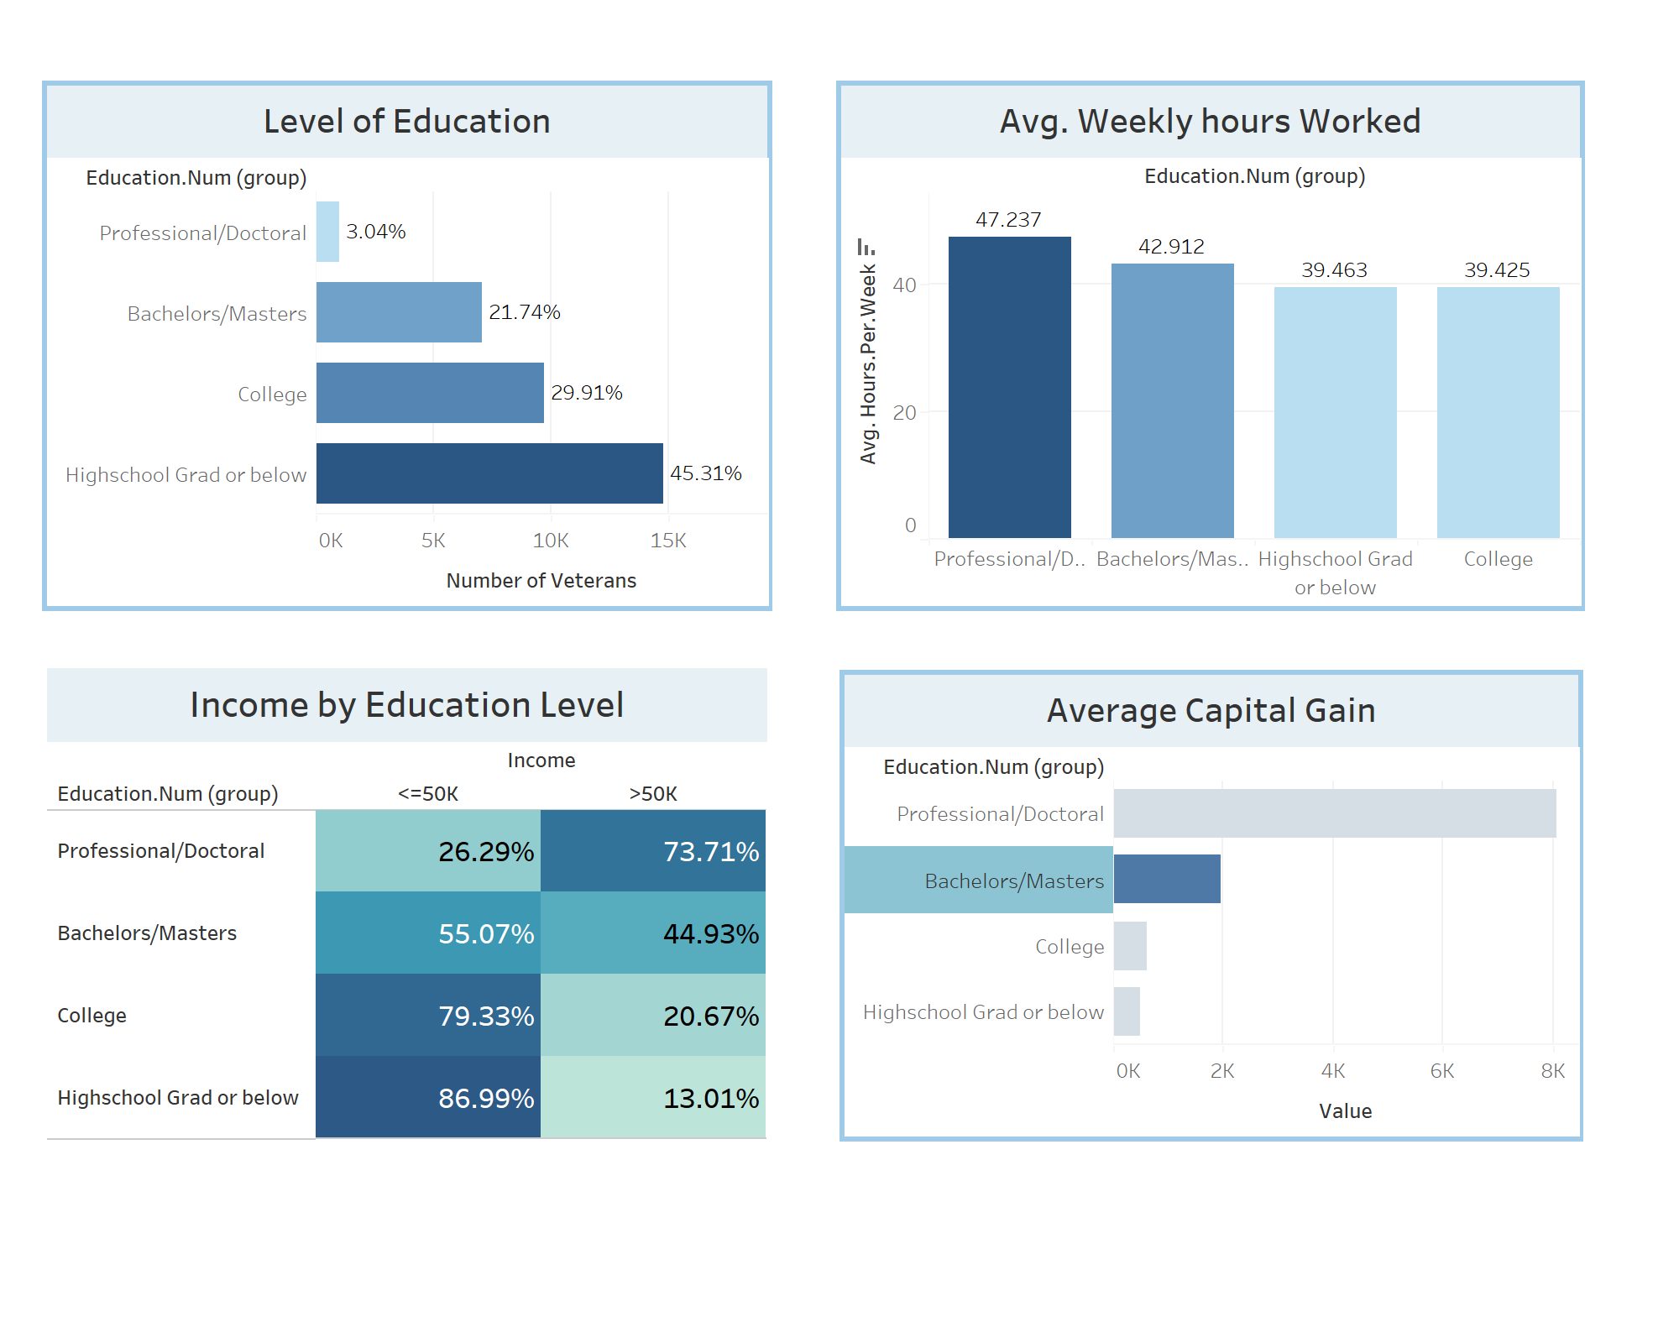
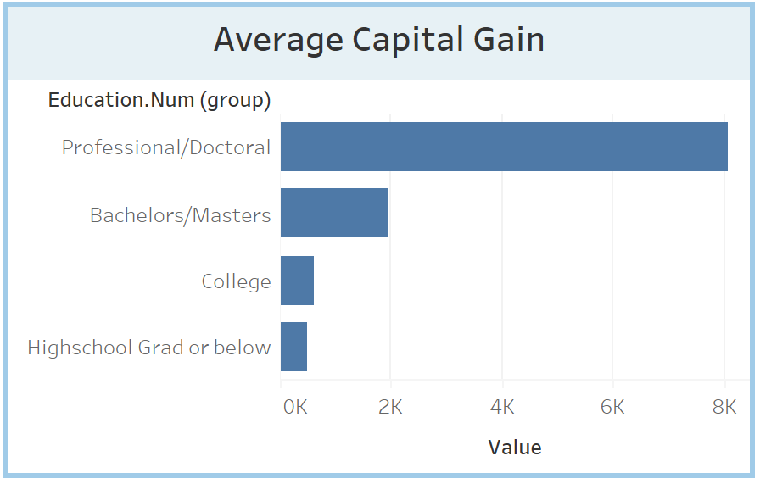
INSIGHTS BASED ON EDUCATION LEVEL
Higher the level of education of veterans, higher the hours worked, higher the income & capital gained.

Slide 6
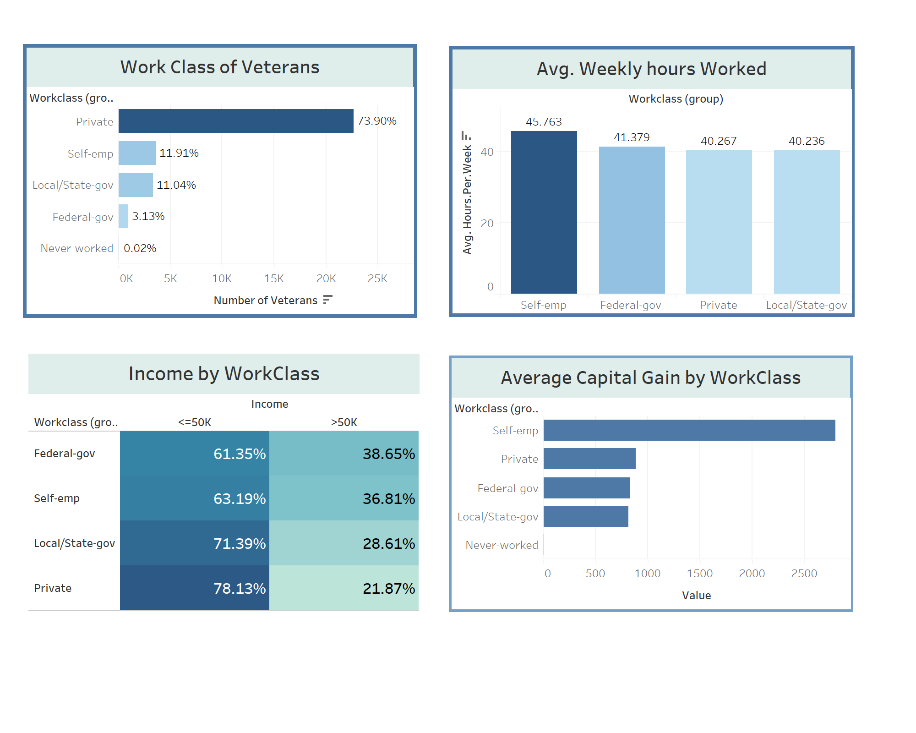
INSIGHTS BASED ON WORK CLASS
More veterans work in private sector. But self-employed veterans works more hours and earns a better income & capital.

Slide 7
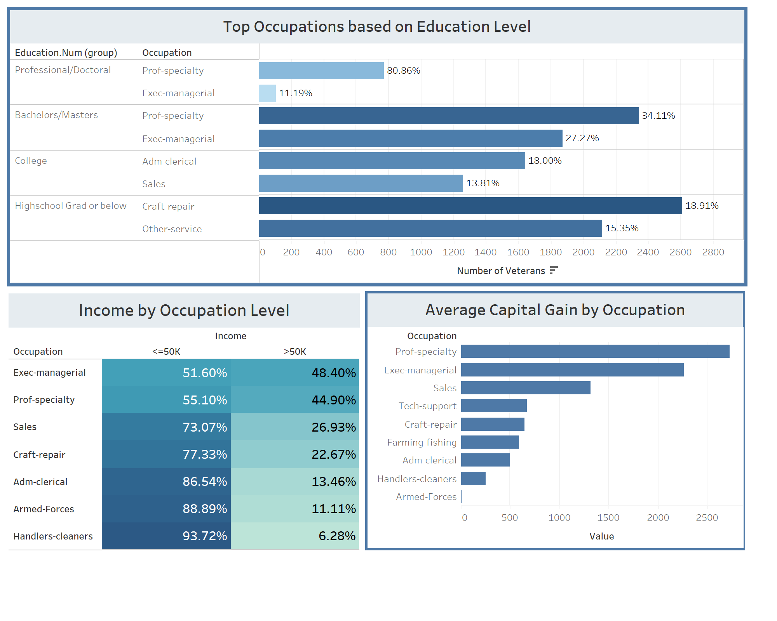
INSIGHTS BASED ON OCCUPATION
Executives and Professionals gain higher income & capital compared to any other jobs.

Slide 8
Best Performing Veterans Are:
Professional/Doctoral Level of Education
Self Employed
Professional/Executive Managerial Positions

Slide 9

Thank you

